Slide 1
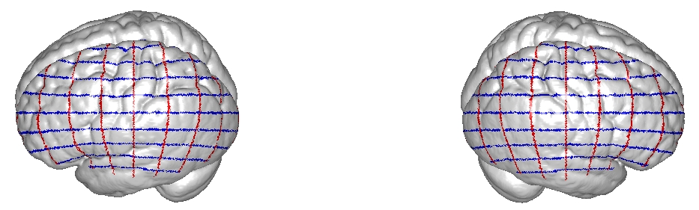
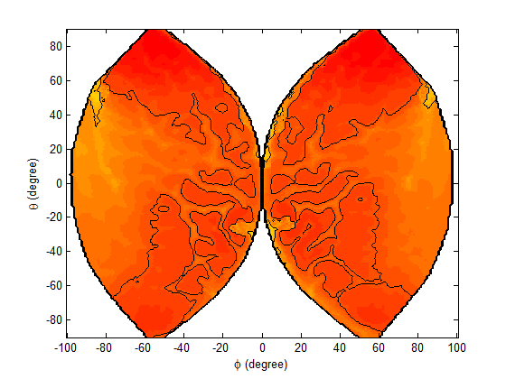
[theta phi] coordinates of brain surface
Left hemisphere
Right hemisphere
-10⁰
40⁰
20⁰
0⁰
-20⁰
-40⁰
10⁰
-20⁰
0⁰
20⁰
40⁰
-20⁰
60⁰
20⁰
-40⁰
60⁰
-30⁰
-60⁰
30⁰
-60⁰
-40⁰
80⁰
θ=-80⁰
40⁰
-80⁰
θ=80⁰
ϕ = -50⁰
ϕ = 50⁰
-60⁰
60⁰
-70⁰
70⁰
-80⁰
80⁰
-90⁰
90⁰
Frontal
Frontal
Left hemisphere
Right hemisphere
Occipital
Occipital

